Slide 1
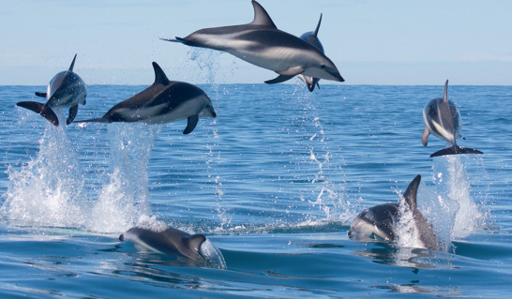



Considerations about PFAS in marine mammals stranded along the Tuscany coast
Michele Mazzetti¹, Sara Valsecchi², Cecilia Mancusi¹, Claudio Roscioli², Letizia Marsili³, Lucia Pierro¹, Paolo Altemura¹
¹Environmental Protection Agency of Tuscany Region, Italy,
²Water Research Institute - Italian National Research Council
³University of Siena, Italy

Slide 2
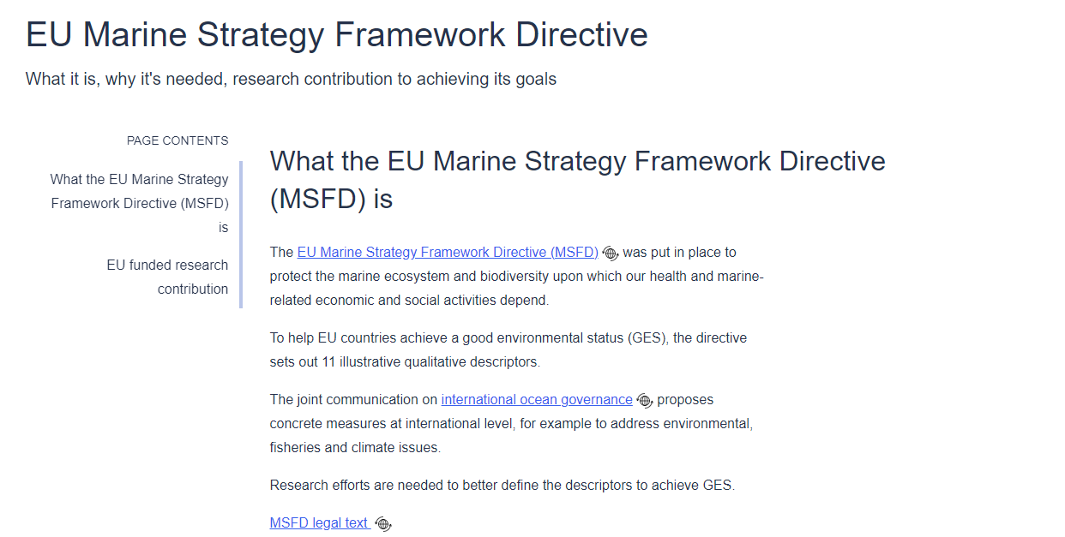
Marine Strategy Framework
Directive 2008/56
Notes:
Food webs are networks of feeding interactions between animals and their food (or predators and prey). This descriptor looks at the functional aspects of marine food webs. In particular, it looks at the diversity and balance between different groups of species and the characteristics of these. It is closely linked to Descriptors 1 and 6 as marine food webs can only be in a good state if marine species and habitats are healthy and in a good condition.

Slide 3
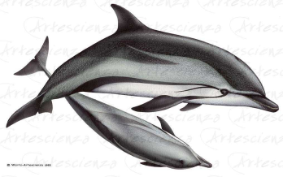
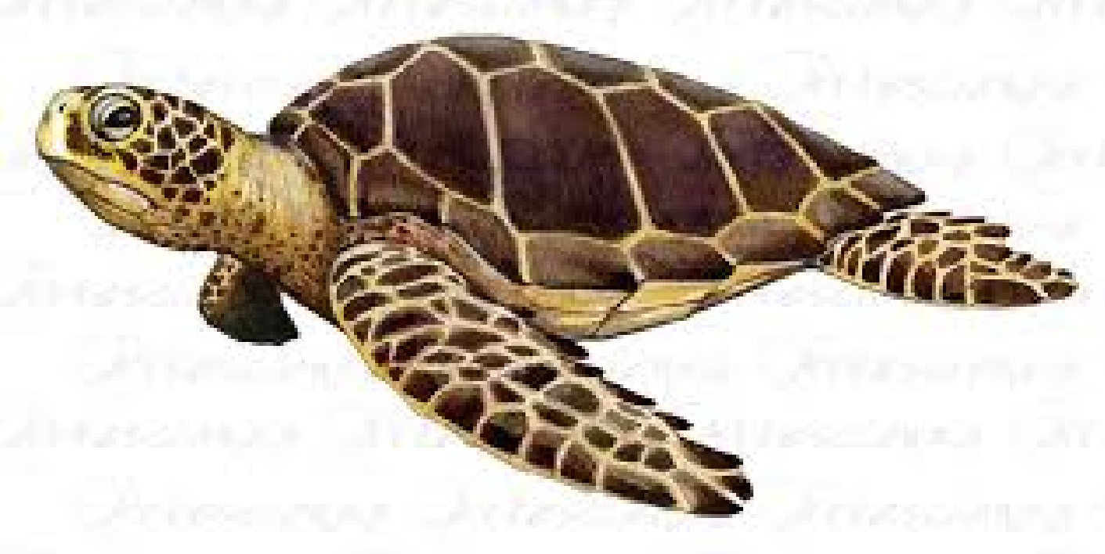
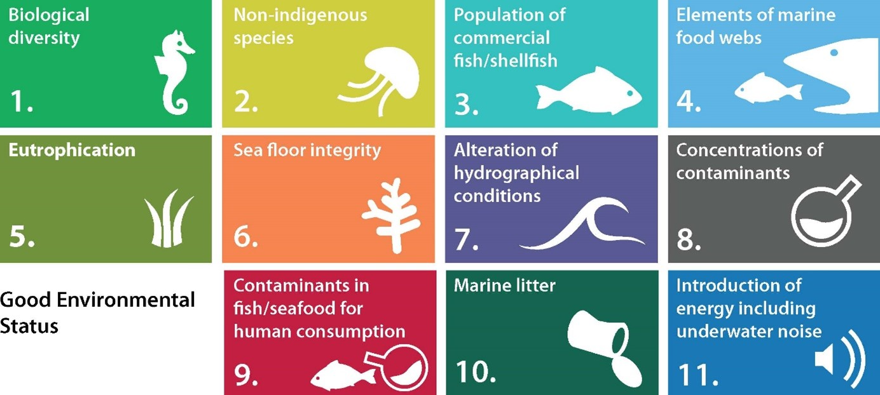
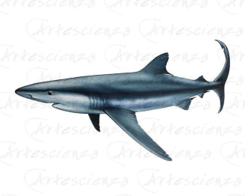
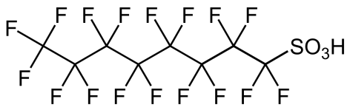
Descriptors under the
Marine Strategy Framework Directive
Reptiles and Marine Mammals
Pelagic habitats
https://www.copernicus.eu/en/news/news/observer-copernicus-marine-service-supports-implementation-marine-strategy-framework
C. Mancusi, Ph.D Thesis, UniSi, 2024
Notes:
The concept of ‘good environmental status’ (GES) is defined by the Marine Directive through eleven descriptors. These describe the state of the marine environment, such as conserving biodiversity or food webs. They also describe anthropogenic pressures on the marine environment such as commercial fisheries, or pollutants such marine litter, contaminants, or the input of energy
Food webs are networks of feeding interactions between animals and their food (or predators and prey). This descriptor looks at the functional aspects of marine food webs. In particular, it looks at the diversity and balance between different groups of species and the characteristics of these. It is closely linked to Descriptors 1 and 6 as marine food webs can only be in a good state if marine species and habitats are healthy and in a good condition.

Slide 4
TARGET
Contribute to expanding the baseline knowledge to adapt the criteria and indicators for achieving Good Environmental Status (GES) as required by the Marine Strategy Framework Directive (2008/56/EC).
Increase monitoring and survey activities for the Regional Environmental Protection Agencies (ARPA) and the National System for Environmental Protection (SNPA)
Provide further knowledge elements regarding descriptors 1, 4, 8, 9, and 10 (BIODIVERSITY-DIET-CONTAMINATION):
Monitor stranded and bycaught cetaceans, sea turtles, and elasmobranchs (descriptor 1)
Study the diet of recovered specimens (descriptor 4)
Analyze Per- and Polyfluoroalkyl Substances (PFAS) (descriptors 8)
C. Mancusi, Ph.D Thesis, UniSi, 2024
Notes:
The concept of ‘good environmental status’ (GES) is defined by the Marine Directive through eleven descriptors. These describe the state of the marine environment, such as conserving biodiversity or food webs. They also describe anthropogenic pressures on the marine environment such as commercial fisheries, or pollutants such marine litter, contaminants, or the input of energy
Food webs are networks of feeding interactions between animals and their food (or predators and prey). This descriptor looks at the functional aspects of marine food webs. In particular, it looks at the diversity and balance between different groups of species and the characteristics of these. It is closely linked to Descriptors 1 and 6 as marine food webs can only be in a good state if marine species and habitats are healthy and in a good condition.

Slide 5
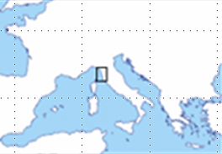
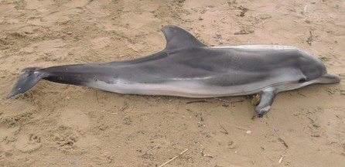
Sampling Area and Samples Collection
Brain
Muscle
Blood
Liver
TUSCANY COAST
C. Mancusi, Ph.D Thesis, UniSi, 2024
Notes:
Verdesca
Mako
Grigio
The concept of ‘good environmental status’ (GES) is defined by the Marine Directive through eleven descriptors. These describe the state of the marine environment, such as conserving biodiversity or food webs. They also describe anthropogenic pressures on the marine environment such as commercial fisheries, or pollutants such marine litter, contaminants, or the input of energy
Food webs are networks of feeding interactions between animals and their food (or predators and prey). This descriptor looks at the functional aspects of marine food webs. In particular, it looks at the diversity and balance between different groups of species and the characteristics of these. It is closely linked to Descriptors 1 and 6 as marine food webs can only be in a good state if marine species and habitats are healthy and in a good condition.

Slide 6
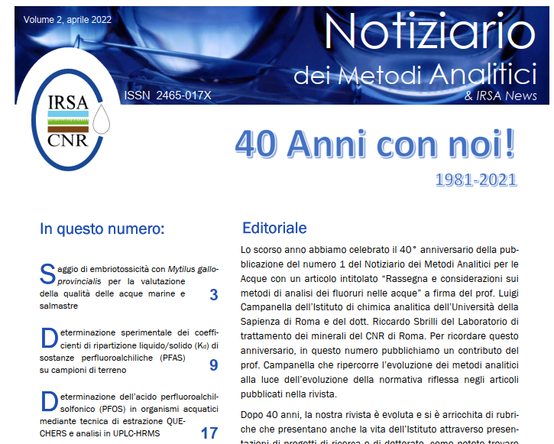
Analytical Method: pH Adjustment in QUECHERs Extraction Step

Slide 7
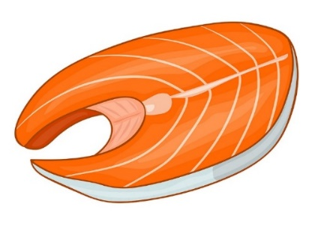
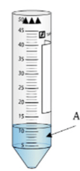

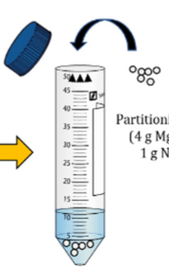



Analytical Method:
Analysis of PFOS in Fish: Modified QUECHERs Extraction
Addition of Extraction Solution (30 µl Wellinghton MPFAC-4_ES diluted to 200 ng/ml with methanol) to 2 g of fish homogeneate.
equilbrate overnight at room temperature and allow to age at -18 °C for approximately one week.
Addition of 0,5 ml of water, 100 µl HCOOH and 1 ceramic homogeneizer,
vortex for 10 minutes
Addition of 10 ml of acetonitrile
vortex for 10 minutes
Addition of 3g of HCOONH₄
vortex for 10 minutes
Centrifugation 15000 g for 10 minutes and collection of upper liquid phase
SPE (GCB 250 mg/6ml), 700 µl of surnatant
Unpublished data

Slide 8
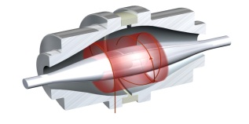
Analytical Method:
Instrumental Conditions
Liquid Chromatography
COLUMN: Kinetex F5 analytical column (150 x 3,0 mm i.d., 2.6 µm particle size, 100 A; Phenomenex, Torrance, CA, USA)
MOBILE PHASES : solution of ammonium acetate in water at 5mM (Phase A) and methanol (Phase B)
INJECTION VOLUME 10 µl., Sandwich mode
GRADIENT PARAMETERS : The gradient employed started at 5% of Phase B increasing to 95% in 20 min and was held for 6.5 min.
SAMPLER VANE AND COLUMN COMPARTMENT TEMPERATURES: The temperatures were set, respectively, at 4ºC and 35ºC
ESI Parameters
FS Parameters
PRM Parameters
Resolution | 70000
Polarity | Negative
ACG Target | 1 x 10⁶
Maximum Injection time | 50 msec
Sheath Gas | 16
Aux Gas | 8
Spray Voltage | 3,70
Capillary temperature | 290ºC
S-Lens RF Level | 55
Aux Gas Temperature | 90ºC
Resolution | 140000
Polarity | Negative
ACG Target | 1 x 10⁶
Maximum Injection time | 100 msec
Mass Range | 100-1000
Inclusion and Exclusion List | Active
Resolution | 35000
Polarity | Negative
ACG Target | 2 x 10⁵
Maximum Injection time | 100 msec
Isolation Width | 4 m/z
Fixed First Mass | 70 m/z
N(CE) Stepped nce | 35
NCE PFAC | 20
NCE PFSC | 35-40

Slide 9
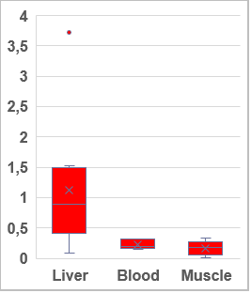
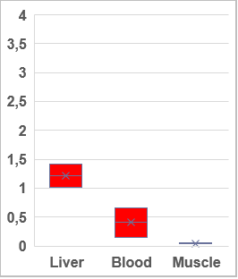

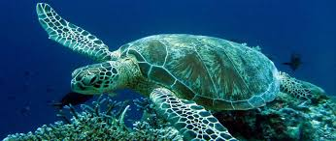
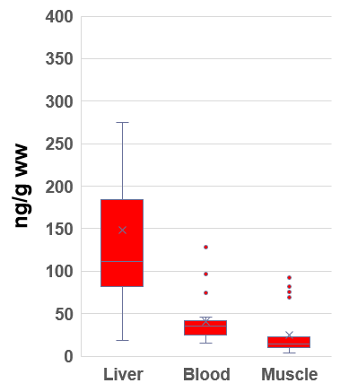
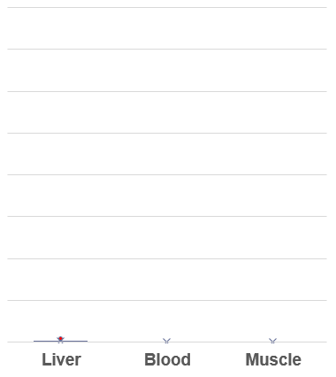
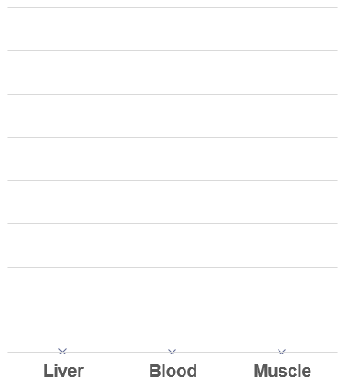
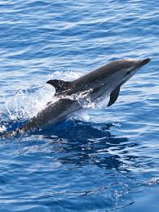
RESULTS: PFOS as Marker
Dolphin (n=66)
Shark (n=20)
Sea turtle (n=6)

Slide 10
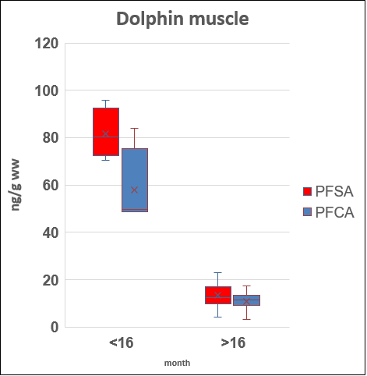
RESULTS:
PFAS in Stenella Specimens: Relationship with Age
Notes:
No differences in PFAS concentrations between male and female were detected
Calves (<15kg, 16months)

Slide 11
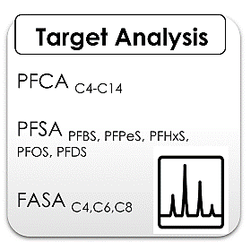
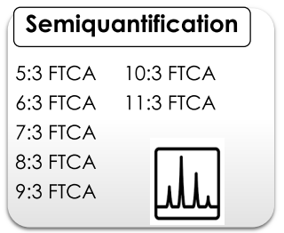


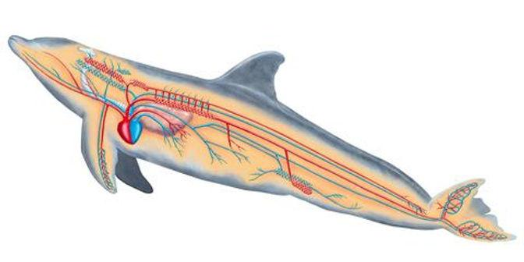

RESULTS:
Target Analysis:
PFAS accumulation
blood stream
PFCA-precursors
FASA
PFSA
blood stream
Short-chain PFAA
PFCA-precursors PFCA
FASA PFSA
Stable intermediates
n:3 FTCA

Slide 12
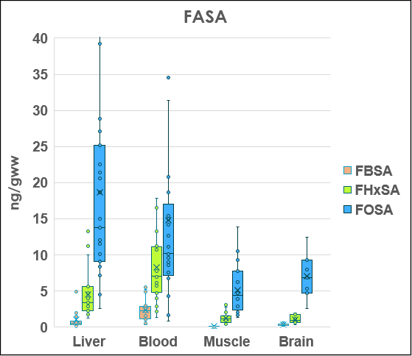
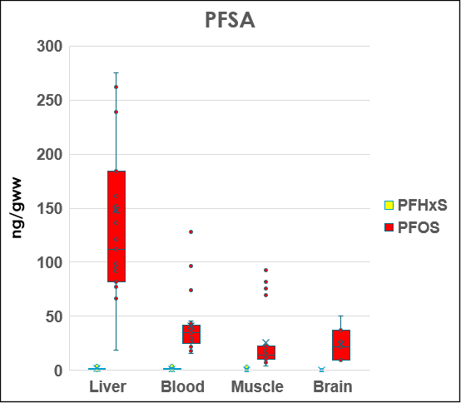
RESULTS:
Target Analysis:
Perfluorosulfonamides and Perfluorosulphonic acid

Slide 13
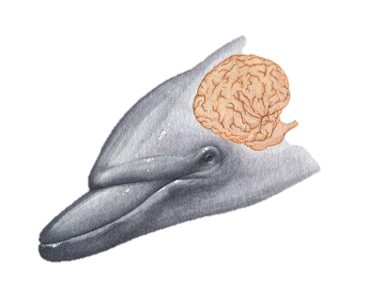


RESULTS:
Tissue Distribution: Muscle and Brain
High values High tissue accumulation
Low values Low tissue accumulation

Slide 14
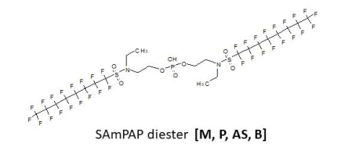
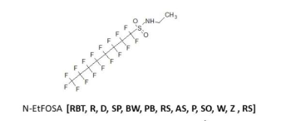
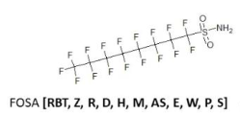
RESULTS:
Further considerations : FOSA possible source
R. C. Kolanczyk et al, Toxics 2023, 11, 74. https://doi.org/10.3390/toxics11010074

Slide 15
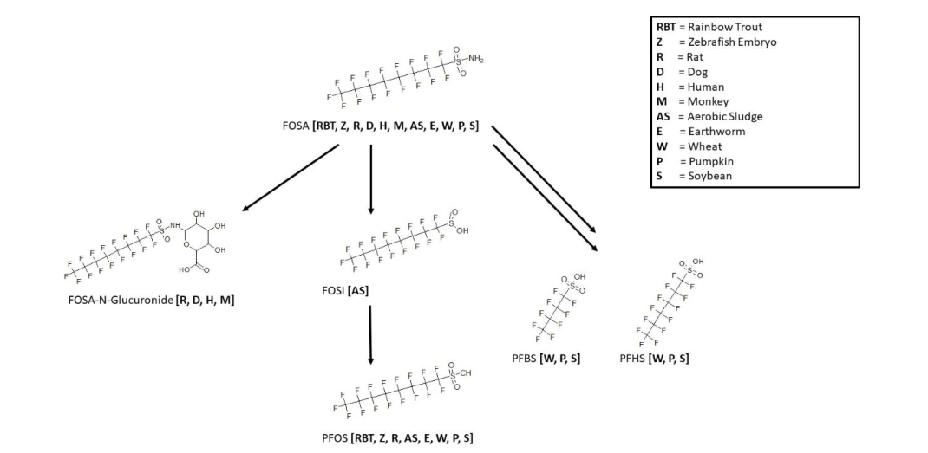
RESULTS:
Further considerations : Metabolic map for Perﬂuorooctanesulfonamide (FOSA)
R. C. Kolanczyk et al, Toxics 2023, 11, 74. https://doi.org/10.3390/toxics11010074

Slide 16
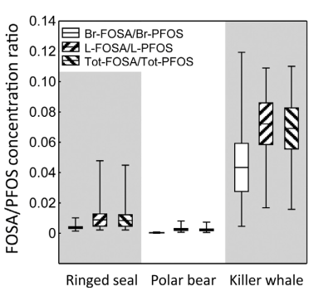
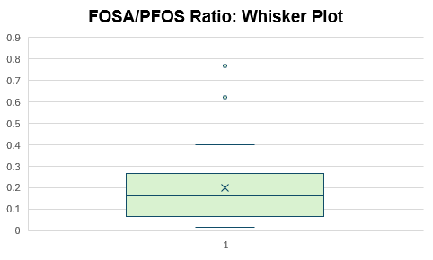
RESULTS:
Further considerations : PFOS vs FOSA
Ratio FOSA/PFOS, 28 samples of Hepatic Tissue of Striped Dolphin
Unpublished data
W.A. Gebbink et al. Chemosphere 144 (2016) 2384–2391
In New Zealand Common Dolphins “FOSA:PFOS ratios reported here were in the range of 0.12 to 1.38 (mean = 0.65; Fig. S2), and comparable to the previously reported range of 0.01 to 1.28 in cetaceans in the Northern Hemisphere (Spaan et al., 2020)” (K.A Stockin et al, Marine Pollution Bulletin 173 (2021) 112896)

Slide 17
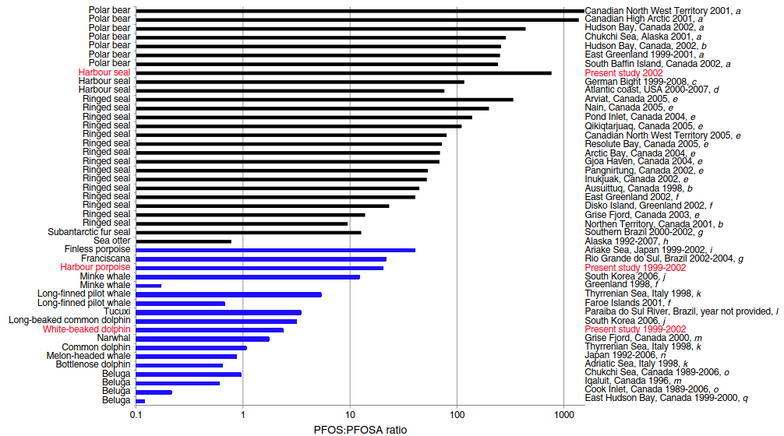
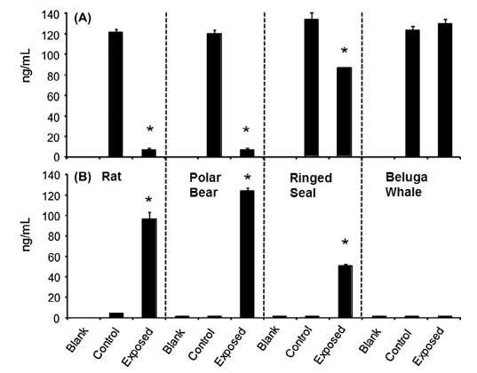
RESULTS:
Further considerations : PFOS vs FOSA
N-EtFOSA depleted and (B) FOSA formed in an in vitro liver assay
A. Galatius et al. Environ Sci Pollut Res DOI 10.1007/s11356-013-1633
R. J. Letcher et al Chemosphere 112 (2014) 225–231
Cetaceans appear to have little or no capacity to convert FOSA to PFOS, as shown by negligible in vitro PFOS formation in beluga liver microsomes and consistently elevated FOSA/PFOS ratios in whales and dolphins compared with pinnipeds and polar bears. Letcher et al., 2014; Galatius et al., 2013; Gebbink et al., 2016; Dassuncao et al., 2017.

Slide 18
RESULTS:
Further considerations about Brain Tissue: PFOS vs FOSA
Unpublished data

Slide 19
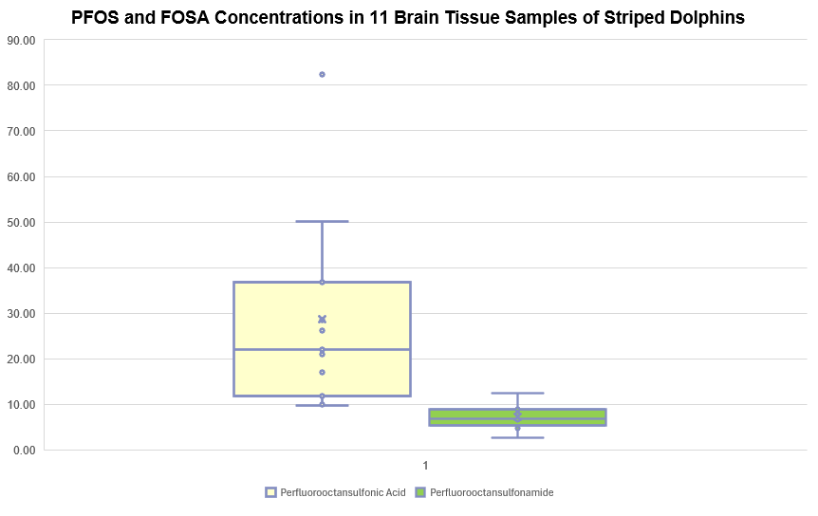
RESULTS:
Further considerations about Brain Tissue: PFOS vs FOSA
Unpublished data

Slide 20
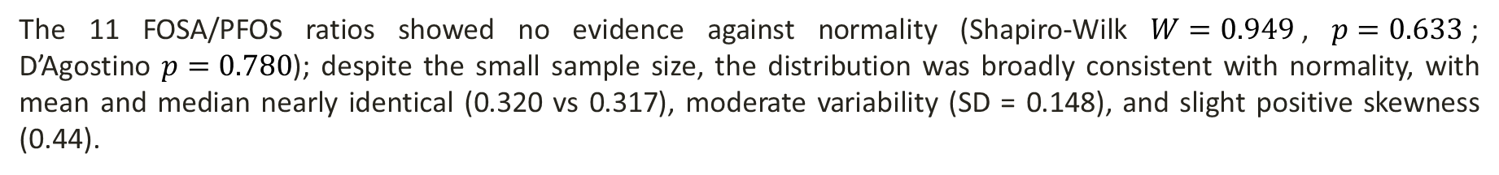
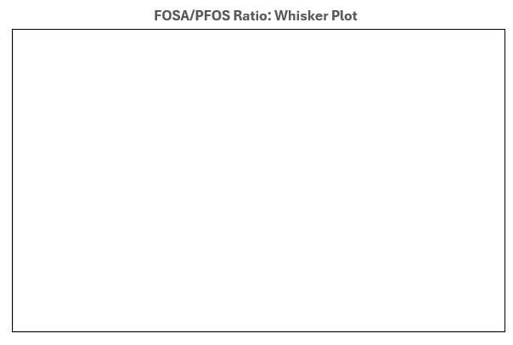
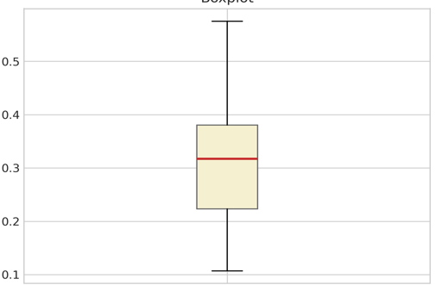
RESULTS:
Further considerations about Brain Tissue: PFOS vs FOSA
Unpublished data

Slide 21
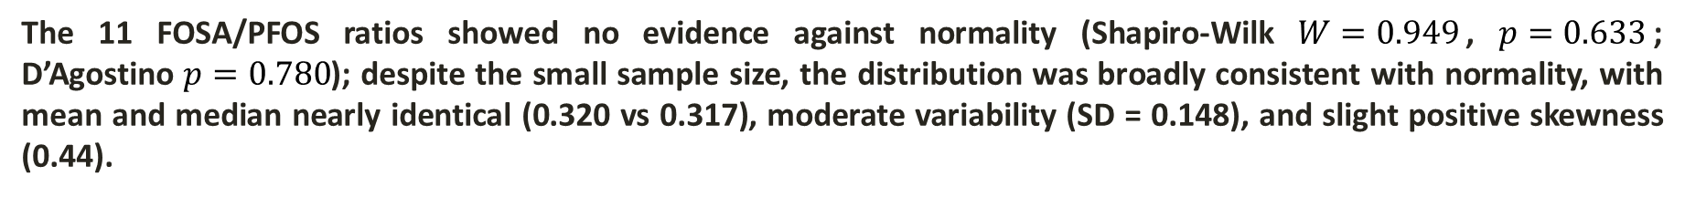
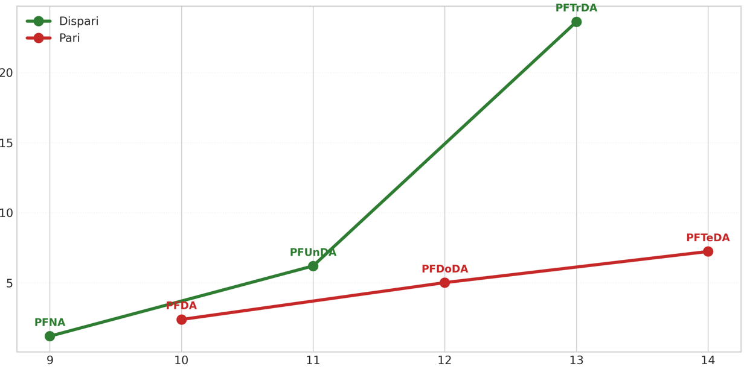
RESULTS:
Further considerations about Brain Tissue: PFOS vs FOSA
Odd
Even
Unpublished data
Notes:
I

Slide 22
CONCLUSIONS:
The results of this study point to the importance of monitoring contaminants in nonconventional biota.
Monitoring persistent and new-generation contaminants plays a priority role: the Mediterranean is a HOTSPOT for both contamination and biodiversity.
Marine mammals in Tyrrhenian sea are contaminated by PFAS
Role of the ecology of the marine organisms in PFAS contamination or/and different capacity in PFAS-precursors metabolisation
In dolphin, uptake of PFAA-precursors and biotransformation to PFAA (partial bioaccumulation of some PFAS-precursors)

